Slide 1
Chapter 10: Other Pubic-Key Cryptosystems
Freshman Seminar
2022.01.21
Sumin Sohn

Slide 2
Contents
10.1 Diffie-Hellman Key Exchange
10.2 Elgamal Cryptographic System
10.3 Elliptic Curve Arithmetic
10.4 Elliptic Curve Cryptography

Slide 3
10.1 Diffie-Hellman Key Exchange

Slide 4
Diffie-Hellman Key Exchange Algorithm
Purpose of the algorithm is to enable 2 users to securely exchange a key that can be used for subsequent symmetric encryption message
Algorithm itself is limited to the exchange of secret values
Depends on effectiveness on the difficulty of computing discrete logarithms

Slide 5
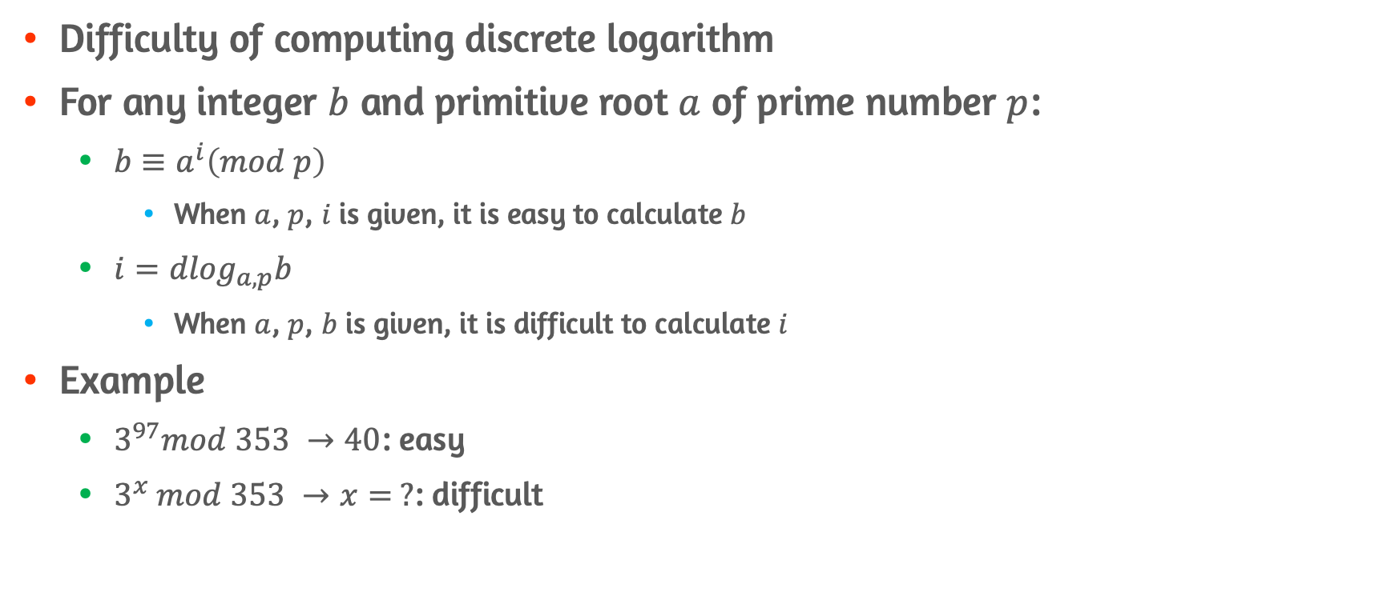
Trapdoor of Diffie-Hellman Key Exchange
Difficulty of computing discrete logarithm
For any integer $b$ and primitive root $a$ of prime number $p$:
$b≡a^{i}\left(mod p\right)$
When $a$, $p$, $i$ is given, it is easy to calculate $b$
$i={dlog}_{a, p}b$
When $a$, $p$, $b$ is given, it is difficult to calculate $i$
Example
$3^{97}mod 353 →40$: easy
$3^{x} mod 353 →x= ?$: difficult

Slide 6
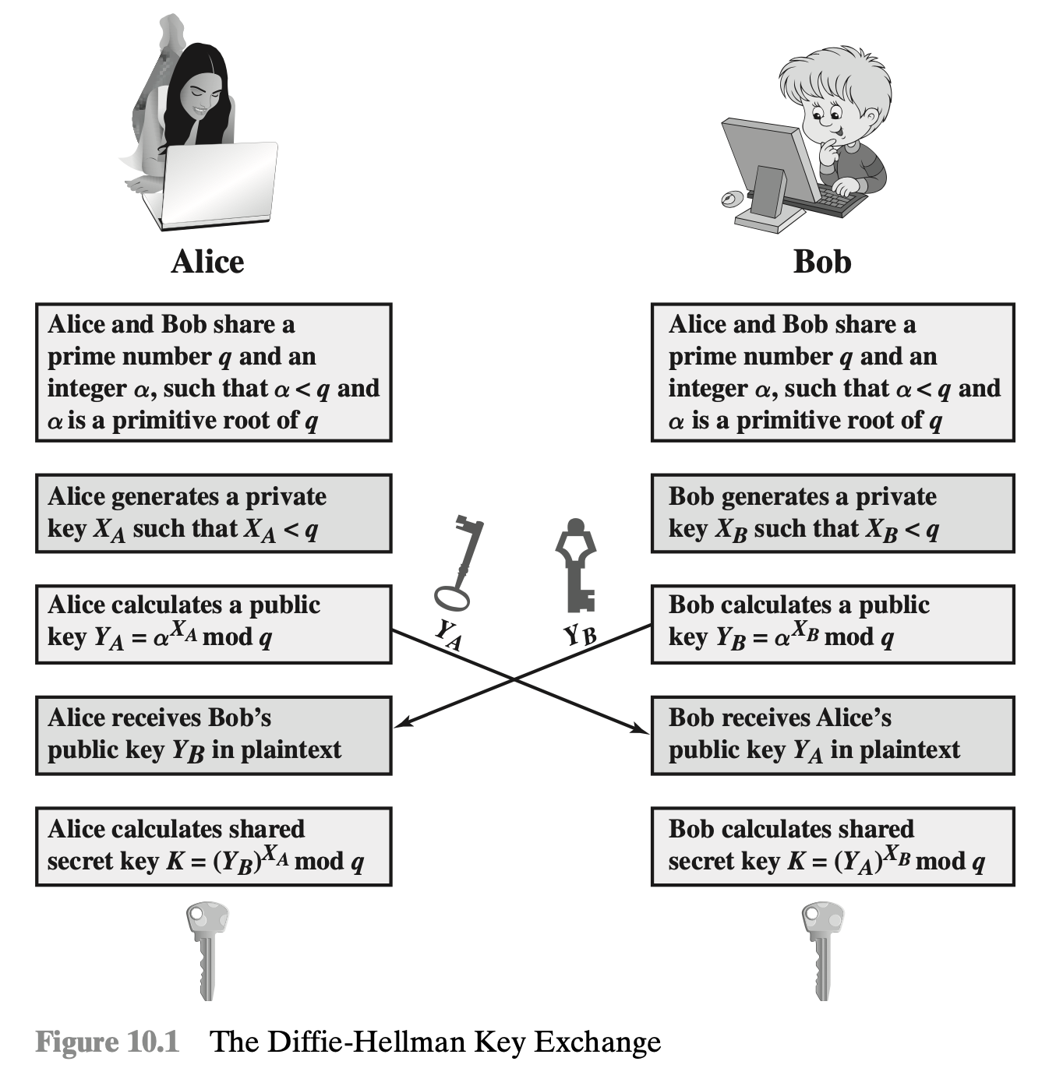
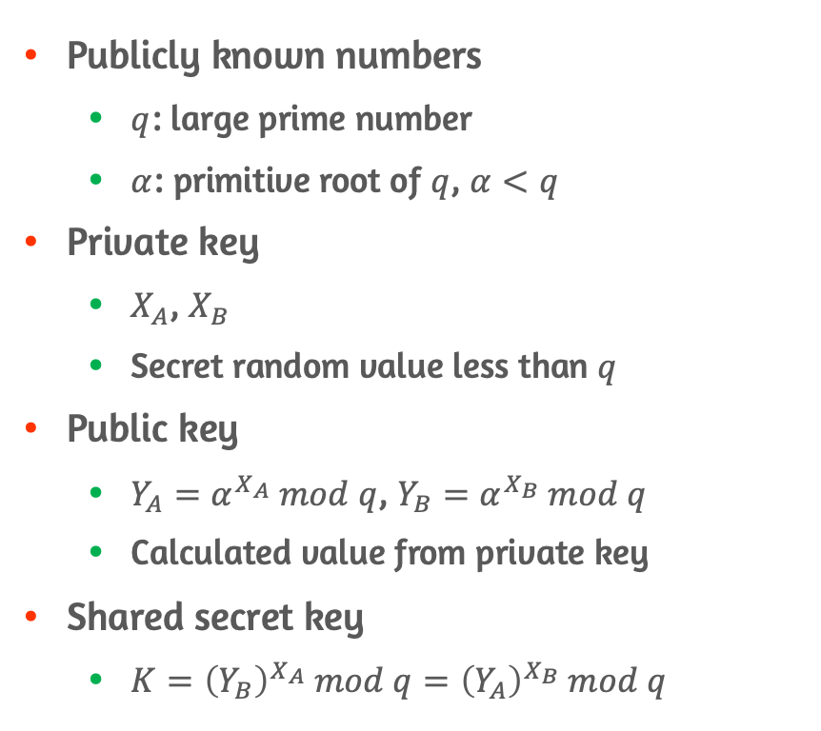
Algorithm Parameters
Publicly known numbers
$q$: large prime number
$α$: primitive root of $q$, $α<q$
Private key
$X_{A}$, $X_{B}$
Secret random value less than $q$
Public key
$Y_{A}=α^{X_{A}} mod q$, $Y_{B}=α^{X_{B}} mod q$
Calculated value from private key
Shared secret key
$K={\left(Y_{B}\right)}^{X_{A}} mod q={\left(Y_{A}\right)}^{X_{B}} mod q$

Slide 7
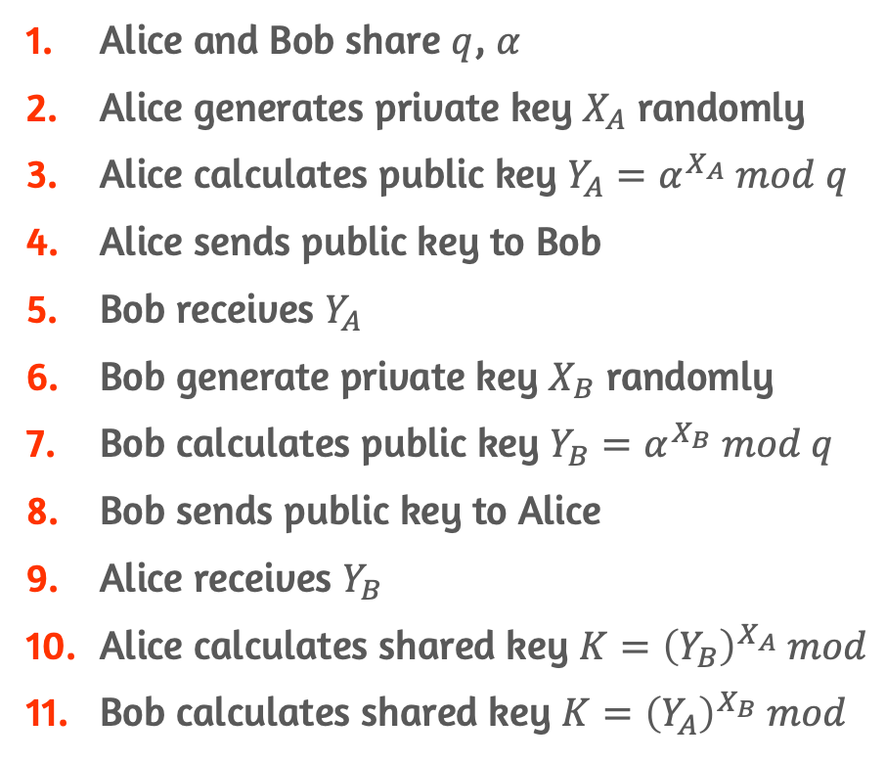
Algorithm Procedures
Alice and Bob share $q$, $α$
Alice generates private key $X_{A}$ randomly
Alice calculates public key $Y_{A}=α^{X_{A}} mod q$
Alice sends public key to Bob
Bob receives $Y_{A}$
Bob generate private key $X_{B}$ randomly
Bob calculates public key $Y_{B}=α^{X_{B}} mod q$
Bob sends public key to Alice
Alice receives $Y_{B}$
Alice calculates shared key $K={\left(Y_{B}\right)}^{X_{A}} mod$
Bob calculates shared key $K={\left(Y_{A}\right)}^{X_{B}} mod$

Slide 8
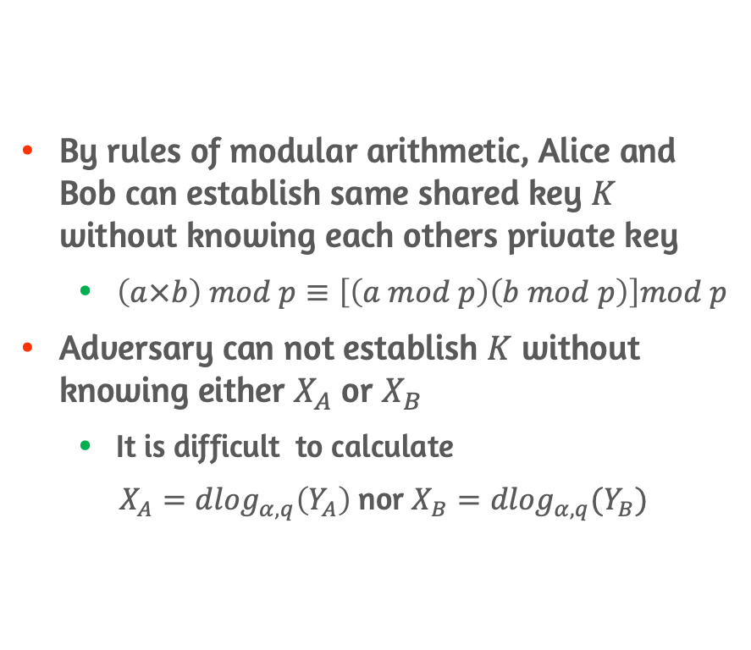

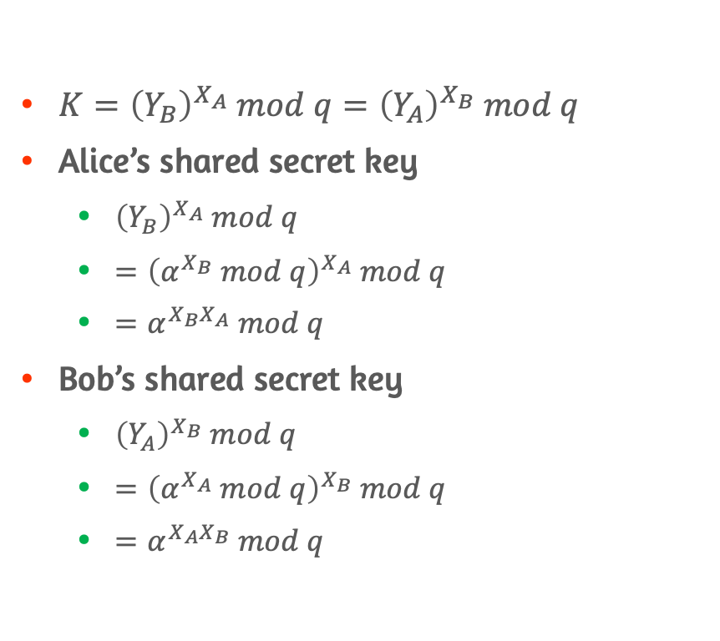
Shared Secret Key $K$
By rules of modular arithmetic, Alice and Bob can establish same shared key $K$ without knowing each others private key
$\left(a×b\right) mod p≡\left[\left(a mod p\right)\left(b mod p\right)\right]mod p$
Adversary can not establish $K$ without knowing either $X_{A}$ or $X_{B}$
It is difficult to calculate
$X_{A}={dlog}_{α, q}\left(Y_{A}\right)$ nor $X_{B}={dlog}_{α, q}(Y_{B})$
$K={\left(Y_{B}\right)}^{X_{A}} mod q={\left(Y_{A}\right)}^{X_{B}} mod q$
Alice’s shared secret key
${\left(Y_{B}\right)}^{X_{A}} mod q$
$={\left(α^{X_{B}} mod q\right)}^{X_{A}} mod q$
$=α^{X_{B}X_{A}} mod q$
Bob’s shared secret key
${\left(Y_{A}\right)}^{X_{B}} mod q$
$={\left(α^{X_{A}} mod q\right)}^{X_{B}} mod q$
$=α^{X_{A}X_{B}} mod q$

Slide 9
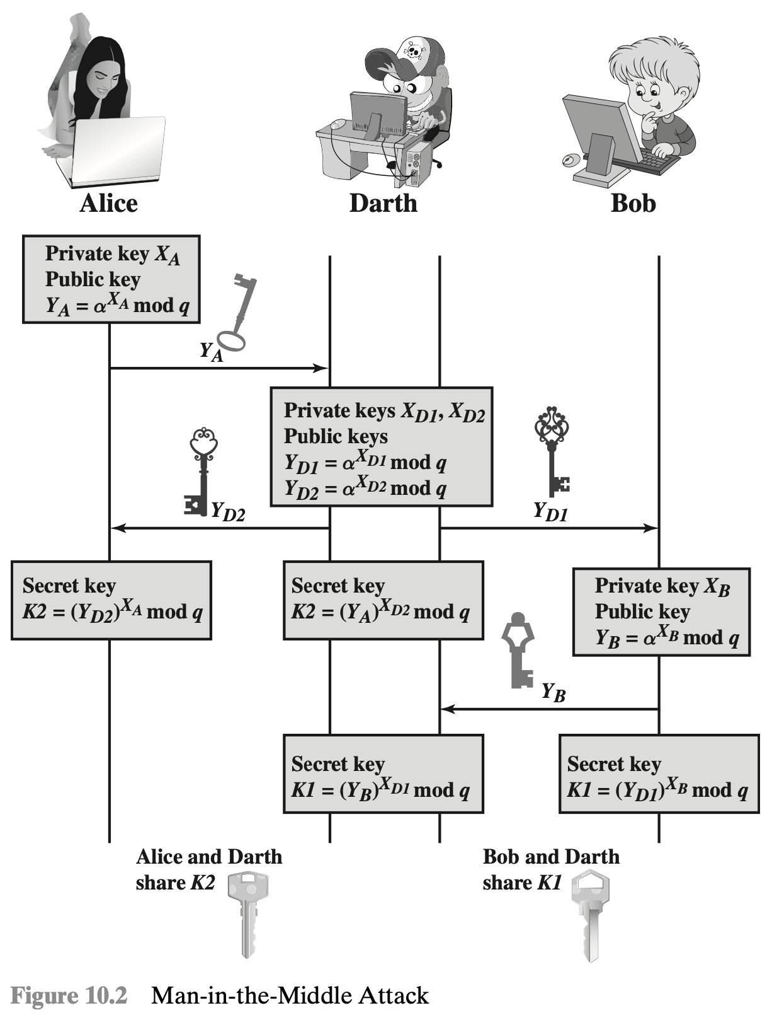
Man-in-the-Middle-Attack
Diffie-Hellman key exchange algorithm is insecure from MitM attack
Adversary can establish 2 sperate shared secret keys during key exchanging procedure by imitating each other
Adversary could read, relay, and manipulate communication between Alice and Bob
This problem occurs due to lack of authentication
Could be mitigated by use of digital signatures and public-key certificates

Slide 10
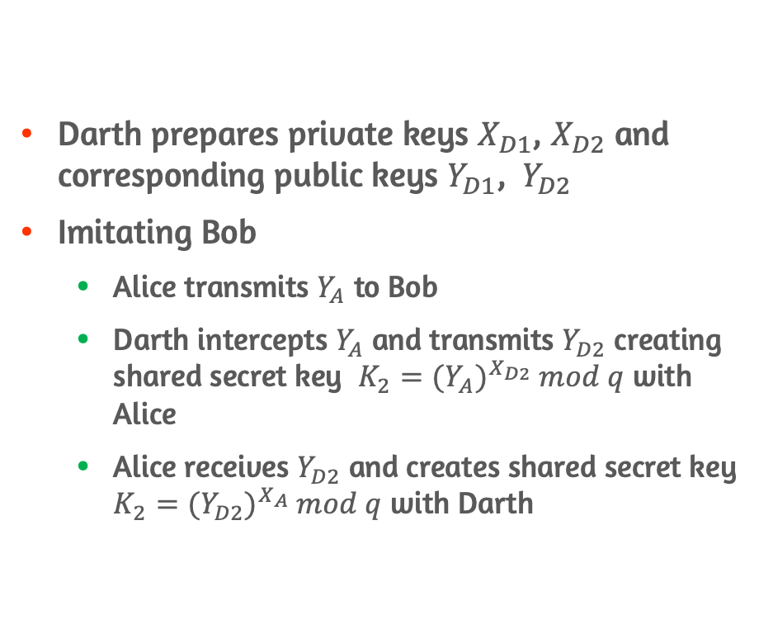
MitM Procedures - Alice
Darth prepares private keys $X_{D1}$, $X_{D2}$ and corresponding public keys $Y_{D1}$, $Y_{D2}$
Imitating Bob
Alice transmits $Y_{A}$ to Bob
Darth intercepts $Y_{A}$ and transmits $Y_{D2}$ creating shared secret key $K_{2}={{(Y}_{A})}^{X_{D2}} mod q$ with Alice
Alice receives $Y_{D2}$ and creates shared secret key $K_{2}={{(Y}_{D2})}^{X_{A}} mod q$ with Darth

Slide 11
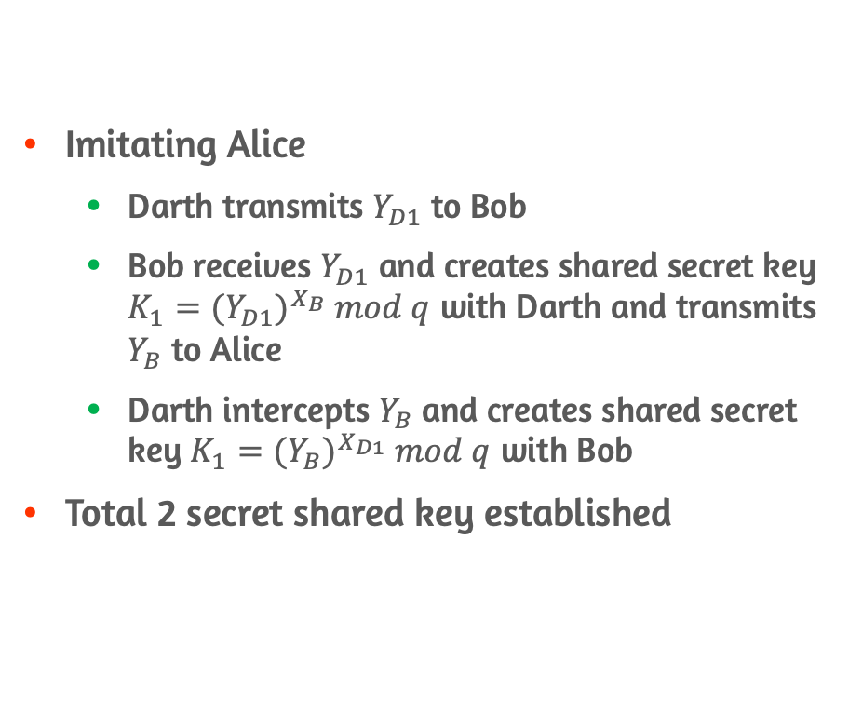
MitM Procedures - Bob
Imitating Alice
Darth transmits $Y_{D1}$ to Bob
Bob receives $Y_{D1}$ and creates shared secret key $K_{1}={{(Y}_{D1})}^{X_{B}} mod q$ with Darth and transmits $Y_{B}$ to Alice
Darth intercepts $Y_{B}$ and creates shared secret key $K_{1}={{(Y}_{B})}^{X_{D1}} mod q$ with Bob
Total 2 secret shared key established

Slide 12
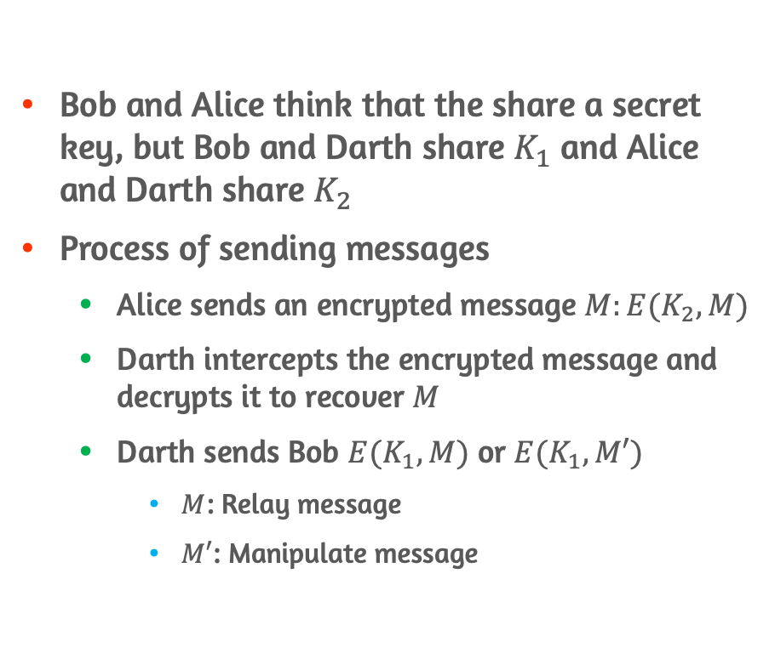
MitM - Sending Messages
Bob and Alice think that the share a secret key, but Bob and Darth share $K_{1}$ and Alice and Darth share $K_{2}$
Process of sending messages
Alice sends an encrypted message $M:E(K_{2}, M)$
Darth intercepts the encrypted message and decrypts it to recover $M$
Darth sends Bob $E(K_{1}, M)$ or $E(K_{1}, M′)$
$M$: Relay message
$M′$: Manipulate message

Slide 13
10.2 Elgamal Cryptographic System

Slide 14
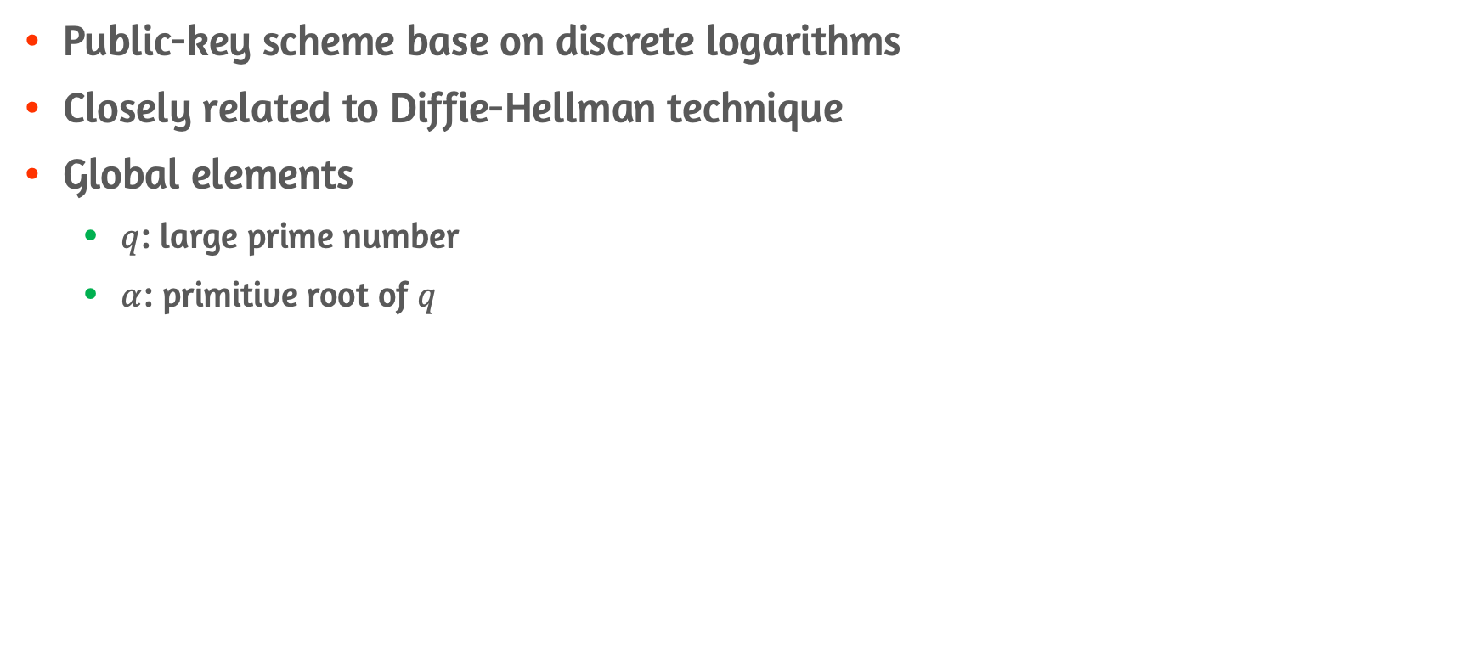
Introduction of Elgamal Cryptosystem
Public-key scheme base on discrete logarithms
Closely related to Diffie-Hellman technique
Global elements
$q$: large prime number
$α$: primitive root of $q$

Slide 15
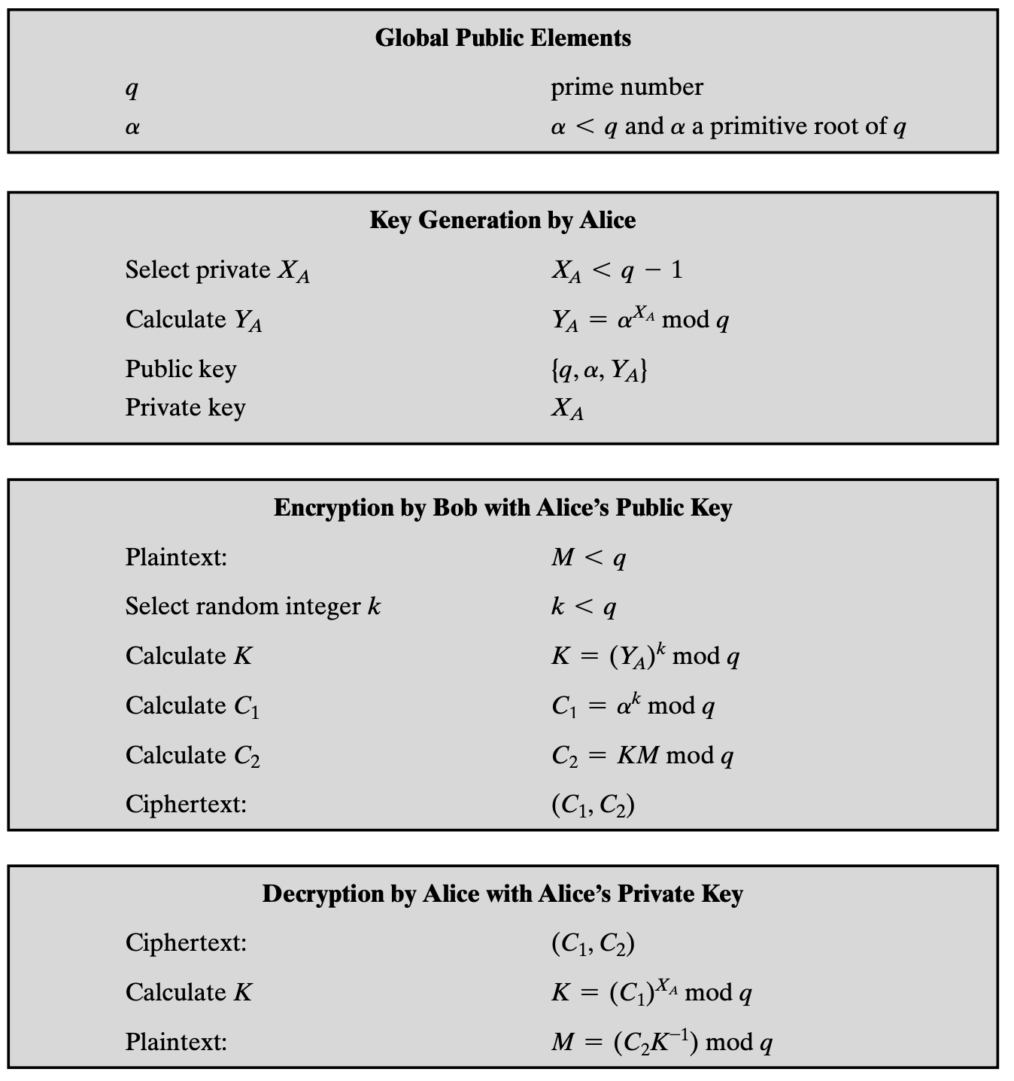
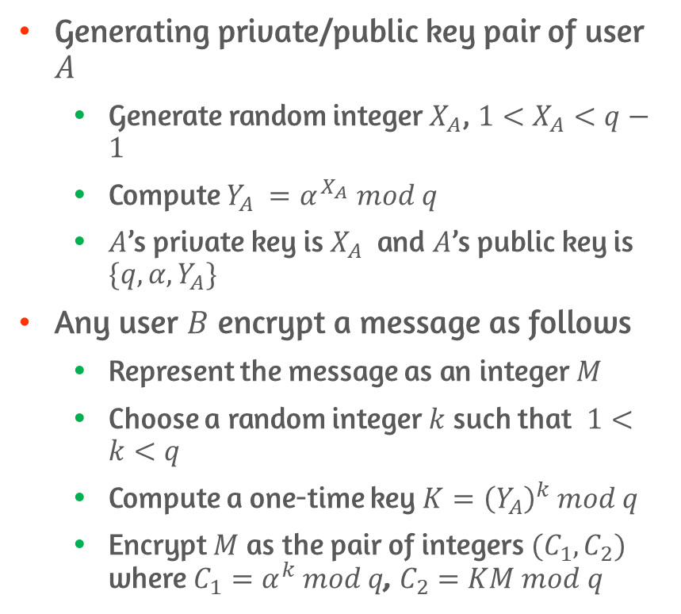
Elgamal Cryptosystem Details #1
Generating private/public key pair of user $A$
Generate random integer $X_{A}$, $1<X_{A}<q−1$
Compute $Y_{A} =α^{X_{A}} mod q$
$A$’s private key is $X_{A}$ and $A$’s public key is $\{q, α,Y_{A}\}$
Any user $B$ encrypt a message as follows
Represent the message as an integer $M$
Choose a random integer $k$ such that $1<k<q$
Compute a one-time key $K={\left(Y_{A}\right)}^{k} mod q$
Encrypt $M$ as the pair of integers $(C_{1}, C_{2})$ where $C_{1}=α^{k} mod q$, $C_{2}=KM mod q$

Slide 16
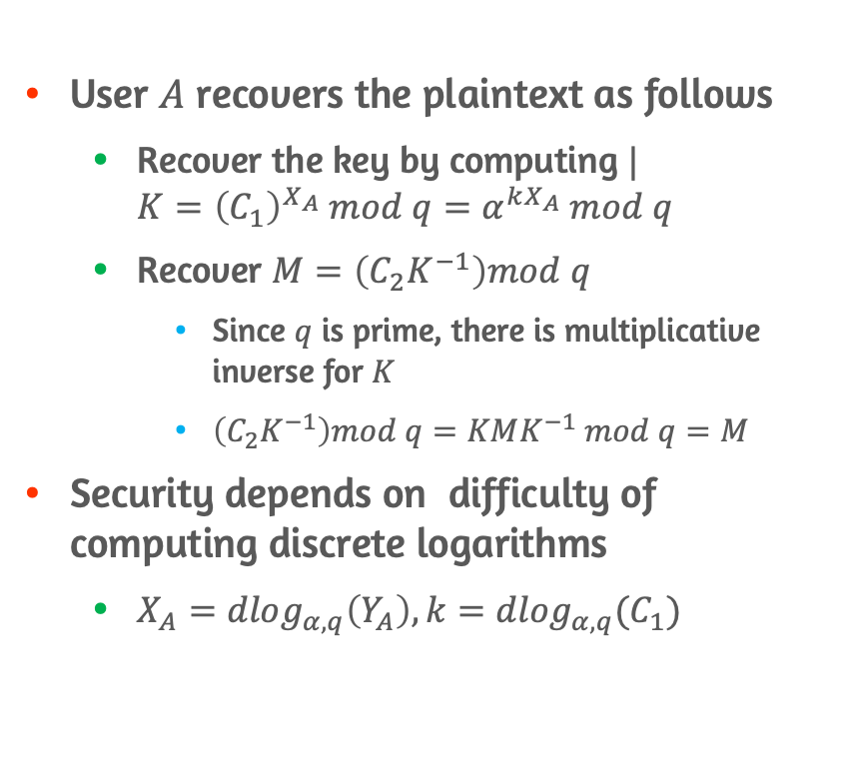
Elgamal Cryptosystem Details #2
User $A$ recovers the plaintext as follows
Recover the key by computing $|$ $K={\left(C_{1}\right)}^{X_{A}} mod q=α^{kX_{A}} mod q$
Recover $M=\left(C_{2}K^{−1}\right)mod q$
Since $q$ is prime, there is multiplicative inverse for $K$
$\left(C_{2}K^{−1}\right)mod q=KMK^{−1} mod q=M$
Security depends on difficulty of computing discrete logarithms
$X_{A}={dlog}_{α, q}\left(Y_{A}\right), k={dlog}_{α, q}(C_{1})$

Slide 17
10.3 Elliptic Curve Arithmetic

Slide 18
Motivation for ECC
Key length for secure RSA use has increased over recent years
ECC offers equal security for a far smaller key size, thereby reducing processing overhead
Symmetric Key Size (bits) | RSA Key Size (bits) | Elliptic Curve Key Size (bits)
80 | 1024 | 160
112 | 2048 | 224
128 | 3072 | 256
192 | 7680 | 384
256 | 15360 | 521
Table 1: NIST Recommended Key Sizes

Slide 19
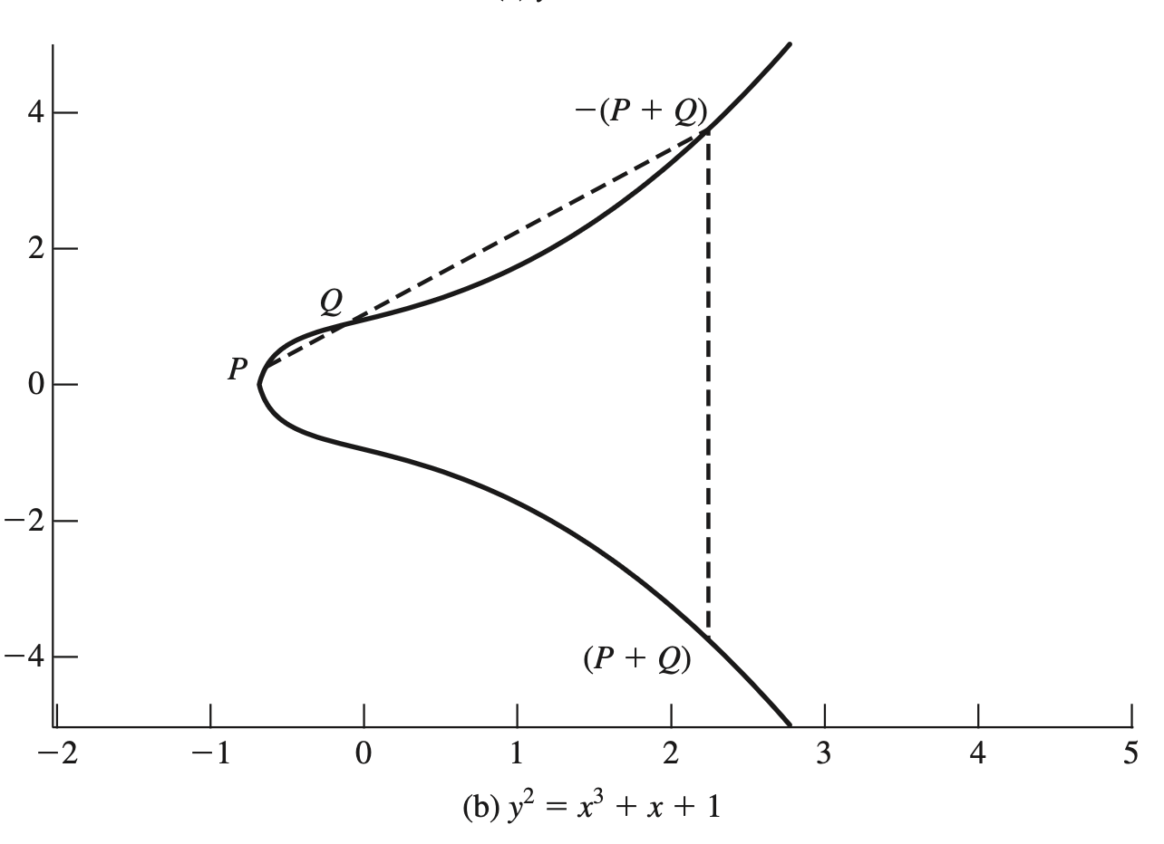
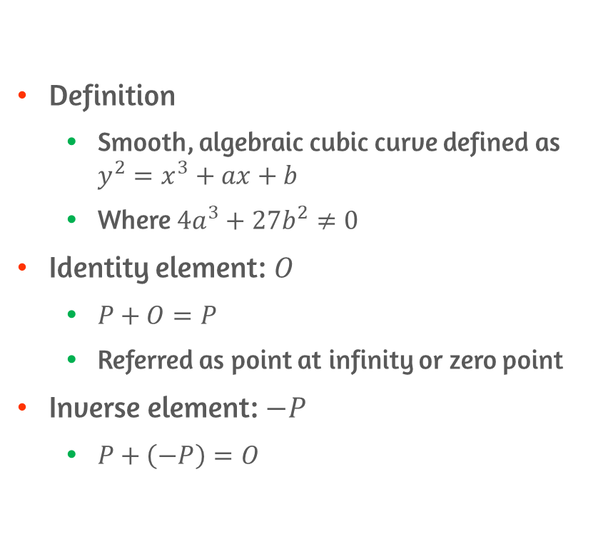
Properties of Elliptic Curves
Definition
Smooth, algebraic cubic curve defined as $y^{2}=x^{3}+ax+b$
Where $4a^{3}+27b^{2}≠0$
Identity element: $O$
$P+O=P$
Referred as point at infinity or zero point
Inverse element: $−P$
$P+\left(−P\right)=O$

Slide 20
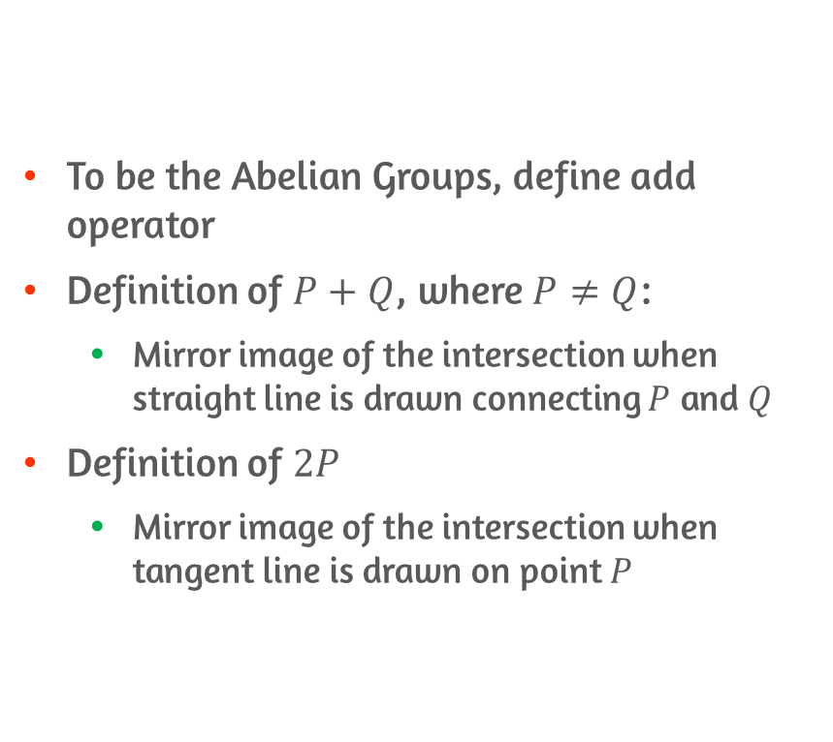
Geometric Description of Addition
To be the Abelian Groups, define add operator
Definition of $P+Q$, where $P≠Q$:
Mirror image of the intersection when straight line is drawn connecting $P$ and $Q$
Definition of $2P$
Mirror image of the intersection when tangent line is drawn on point $P$

Slide 21
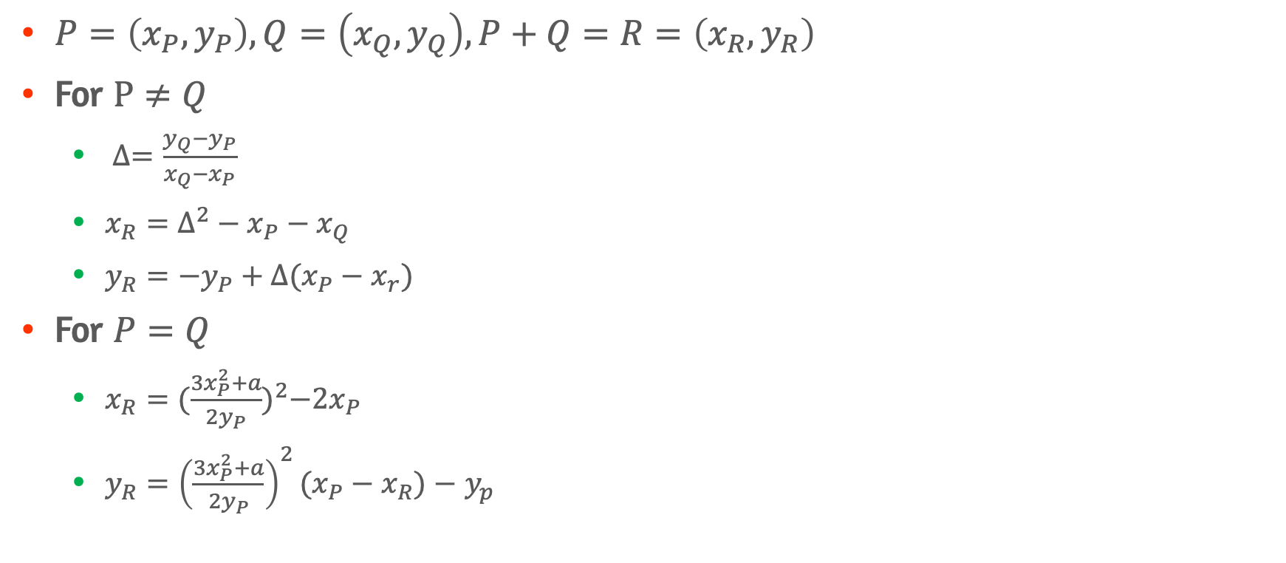
Algebraic Description of Addition
$P=\left(x_{P},y_{P}\right), Q=\left(x_{Q}, y_{Q}\right), P+Q=R=\left(x_{R},y_{R}\right)$
For $P≠Q$
$∆=\frac{y_{Q}−y_{P}}{x_{Q}−x_{P}}$
$x_{R}=∆^{2}−x_{P}−x_{Q}$
$y_{R}=−y_{P}+∆(x_{P}−x_{r})$
For $P=Q$
$x_{R}={(\frac{3x_{P}^{2}+a}{2y_{P}})}^{2}−2x_{P}$
$y_{R}={\left(\frac{3x_{P}^{2}+a}{2y_{P}}\right)}^{2}(x_{P}−x_{R})−$ $y_{p}$

Slide 22
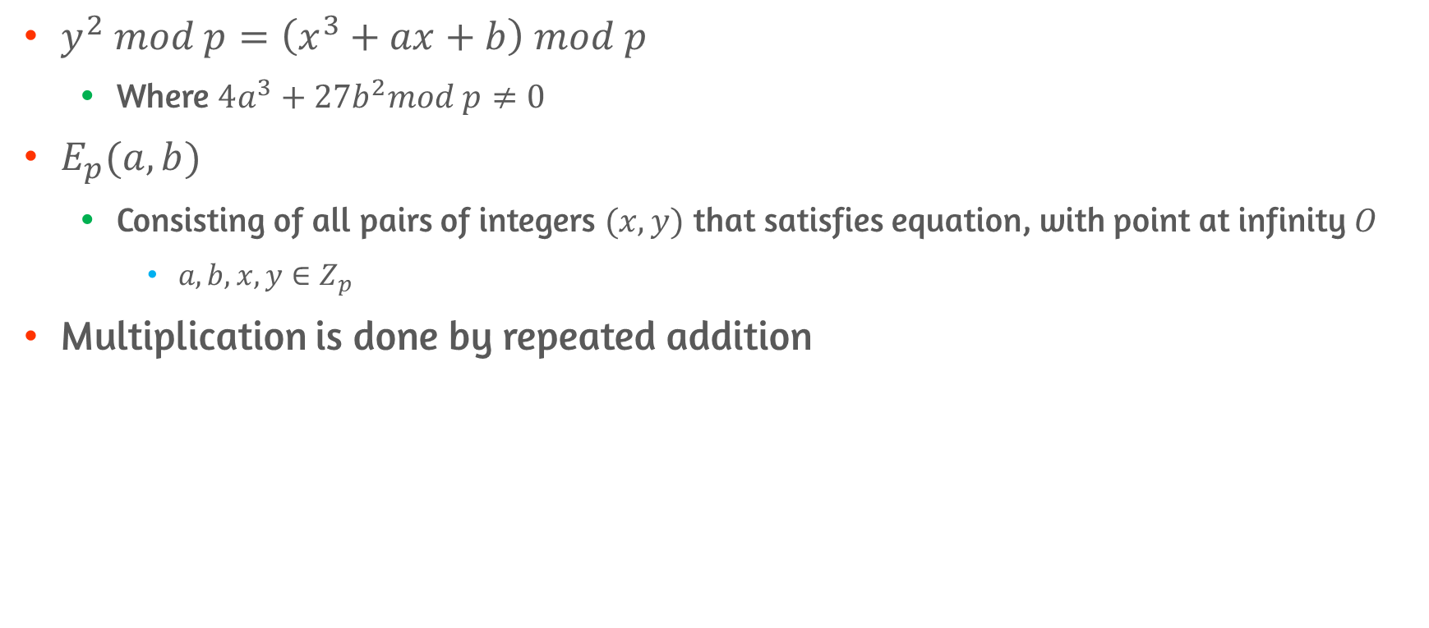

Elliptic Curves Over $Z_{p}$
$y^{2} mod p=\left(x^{3}+ax+b\right) mod p$
Where $4a^{3}+27b^{2}mod p≠0$
$E_{p}(a,b)$
Consisting of all pairs of integers $(x,y)$ that satisfies equation, with point at infinity $O$
$a,b,x,y∈Z_{p}$
Multiplication is done by repeated addition

Slide 23
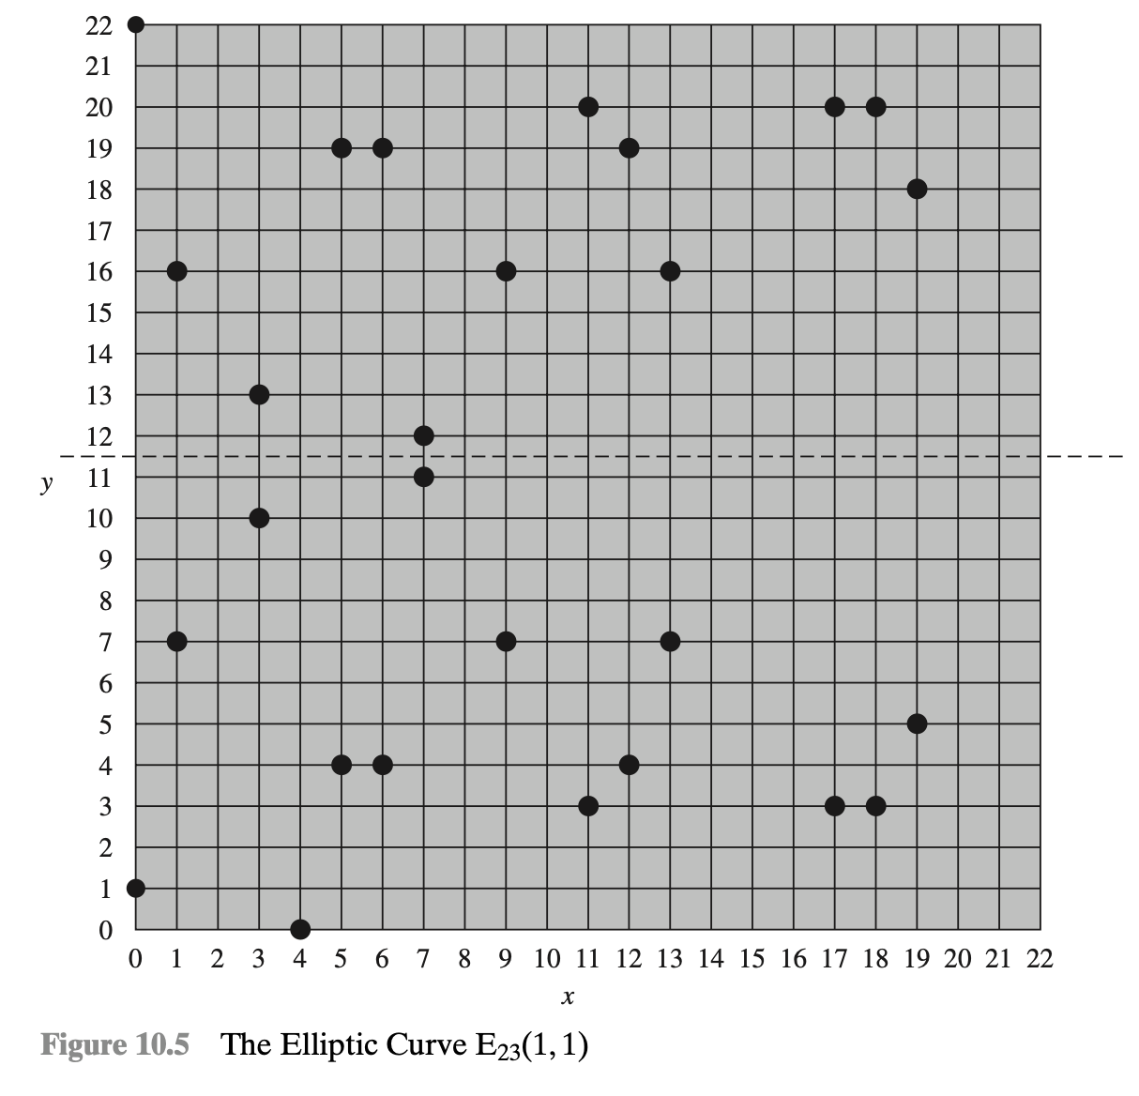
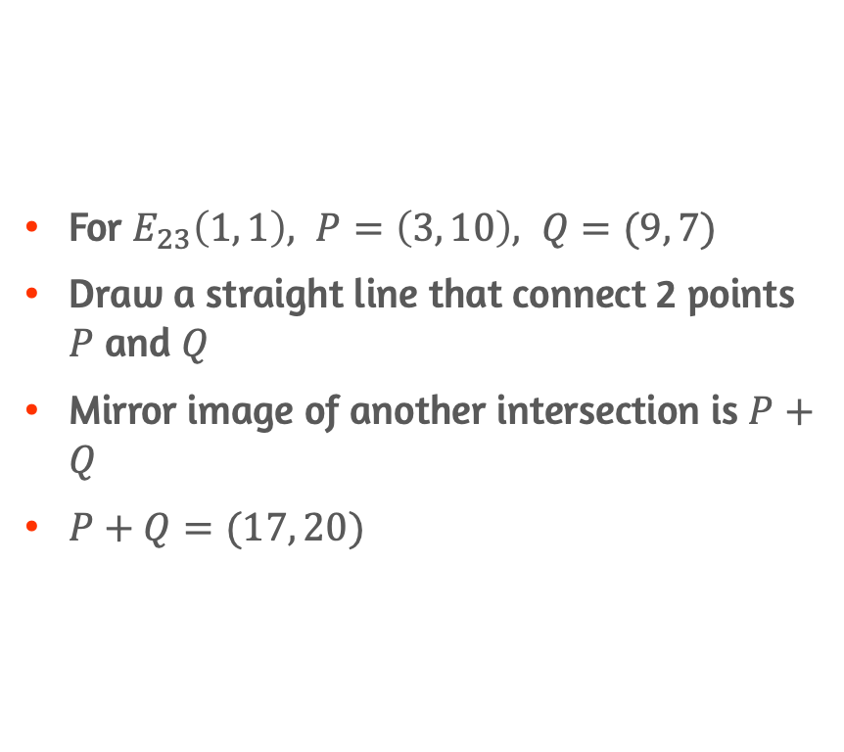

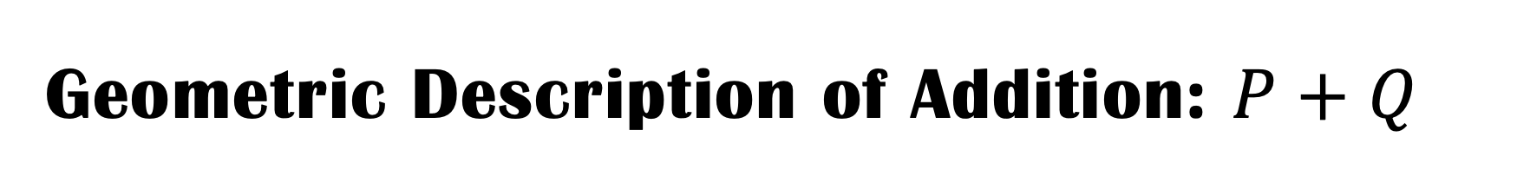

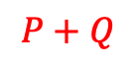
Geometric Description of Addition: $P+Q$
For $E_{23}\left(1, 1\right), P=\left(3, 10\right), Q=(9, 7)$
Draw a straight line that connect 2 points $P$ and $Q$
Mirror image of another intersection is $P+Q$
$P+Q=(17, 20)$
$$P+Q$$
$$P$$
$$Q$$

Slide 24
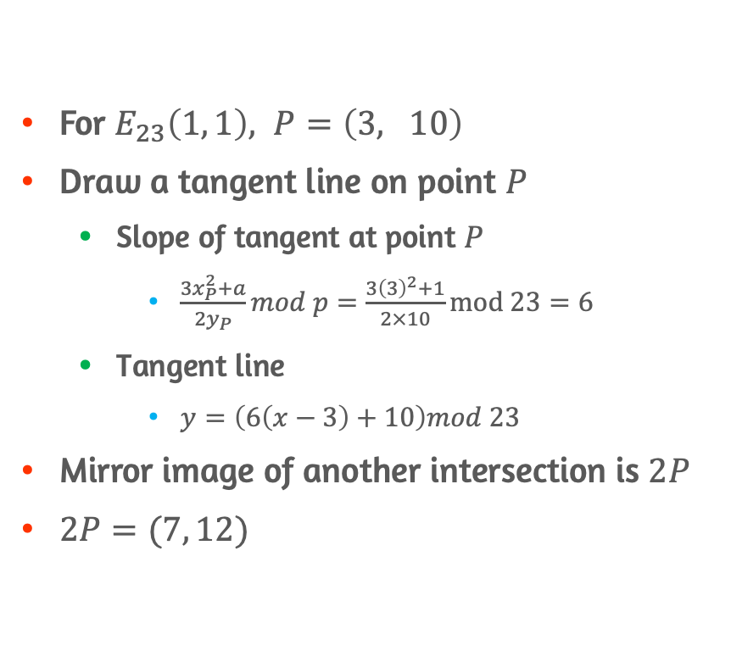


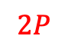
Geometric Description of Addition: $2P$
For $E_{23}\left(1, 1\right), P=\left(3, 10\right)$
Draw a tangent line on point $P$
Slope of tangent at point $P$
$\frac{3x_{P}^{2}+a}{2y_{P}}mod p=\frac{3{\left(3\right)}^{2}+1}{2×10}mod 23=6$
Tangent line
$y=\left(6\left(x−3\right)+10\right)mod 23$
Mirror image of another intersection is $2P$
$2P=(7, 12)$
$$2P$$
$$P$$

Slide 25
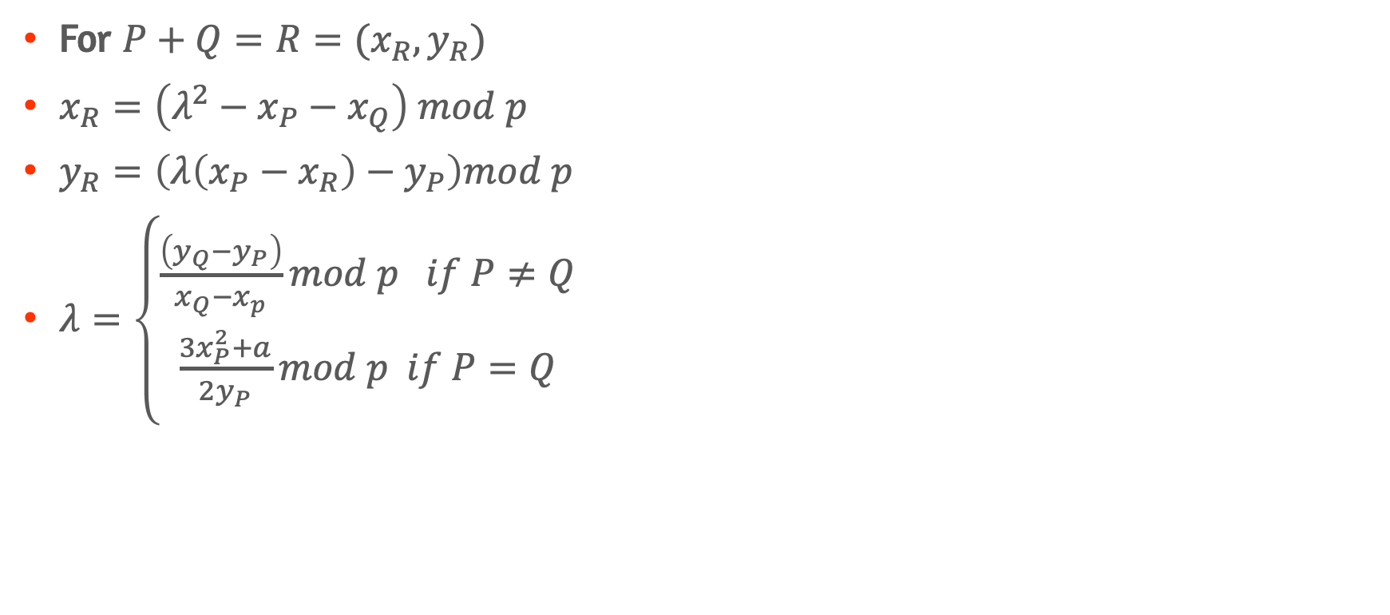
Algebraic Description of Addition
For $P+Q=R=(x_{R},y_{R})$
$x_{R}=\left(λ^{2}−x_{P}−x_{Q}\right) mod p$
$y_{R}=\left(λ\left(x_{P}−x_{R}\right)−y_{P}\right)mod p$
$λ=\left\{\begin{aligned}\frac{\left(y_{Q}−y_{P}\right)}{x_{Q}−x_{p}}mod p if P≠Q \\ \frac{3x_{P}^{2}+a}{2y_{P}}mod p if P=Q\end{aligned}\right.$

Slide 26
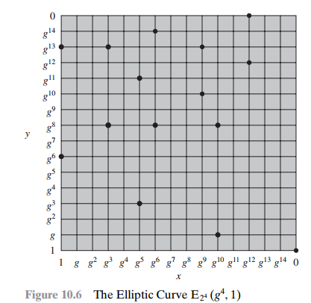
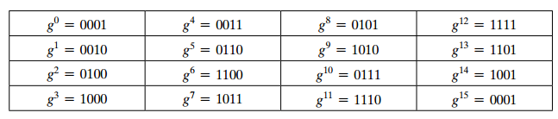
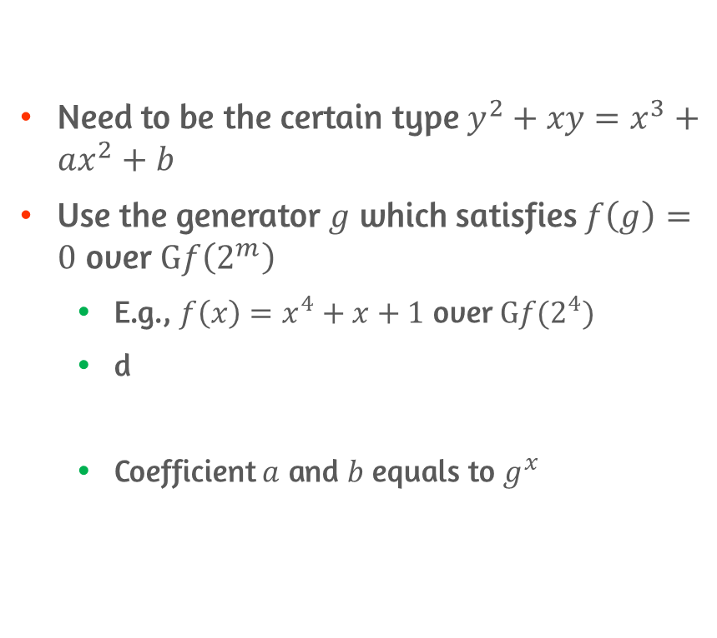

Elliptic Curves over $Gf(2^{m})$
Need to be the certain type $y^{2}+xy=x^{3}+ax^{2}+b$
Use the generator $g$ which satisfies $f\left(g\right)=0$ over $Gf\left(2^{m}\right)$
E.g., $f\left(x\right)=x^{4}+x+1$ over $Gf(2^{4})$
d
Coefficient $a$ and $b$ equals to $g^{x}$

Slide 27
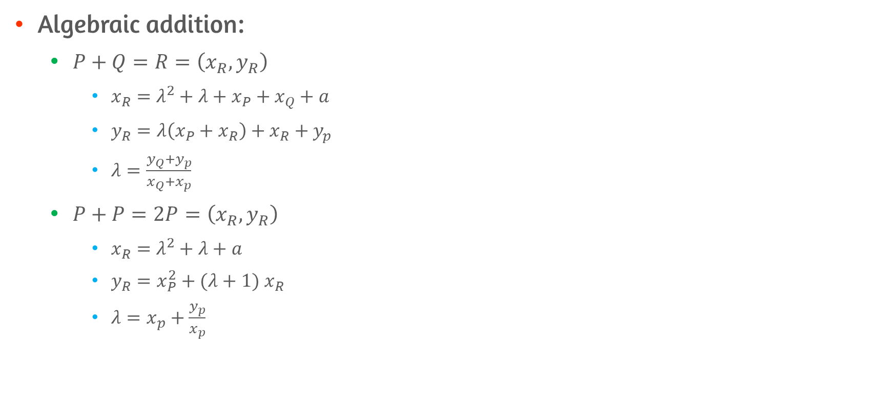
Algebraic Description of Addition
Algebraic addition:
$P+Q=R=\left(x_{R},y_{R}\right)$
$x_{R}=λ^{2}+λ+x_{P}+x_{Q}+a$
$y_{R}=λ\left(x_{P}+x_{R}\right)+x_{R}+y_{p}$
$λ=\frac{y_{Q}+y_{p}}{x_{Q}+x_{p}}$
$P+P=2P$ $=\left(x_{R},y_{R}\right)$
$x_{R}=λ^{2}+λ+a$
$y_{R}=x_{P}^{2}+(λ+1) x_{R}$
$λ=x_{p}+\frac{y_{p}}{x_{p}}$

Slide 28
10.4 Elliptic Curve Cryptography

Slide 29
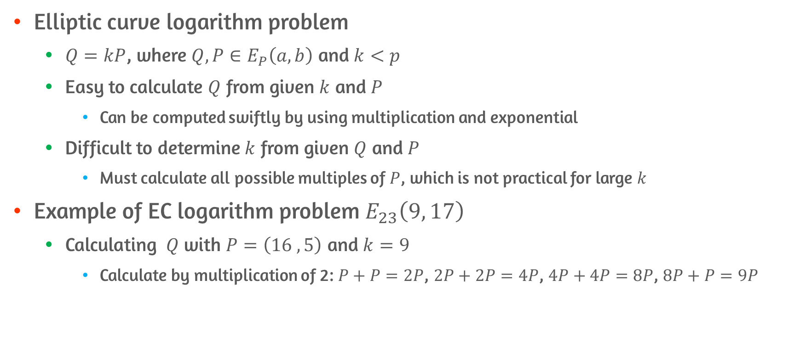
Trapdoor of ECC
Elliptic curve logarithm problem
$Q=kP$, where $Q, P∈E_{P}\left(a,b\right)$ and $k<p$
Easy to calculate $Q$ from given $k$ and $P$
Can be computed swiftly by using multiplication and exponential
Difficult to determine $k$ from given $Q$ and $P$
Must calculate all possible multiples of $P$, which is not practical for large $k$
Example of EC logarithm problem $E_{23}\left(9, 17\right)$
Calculating $Q$ with $P=\left(16 ,5\right)$ and $k=9$
Calculate by multiplication of 2: $P+P=2P$, $2P+2P=4P$, $4P+4P=8P$, $8P+P=9P$

Slide 30
Analog of Diffie-Hellman Key Exchange

Slide 31
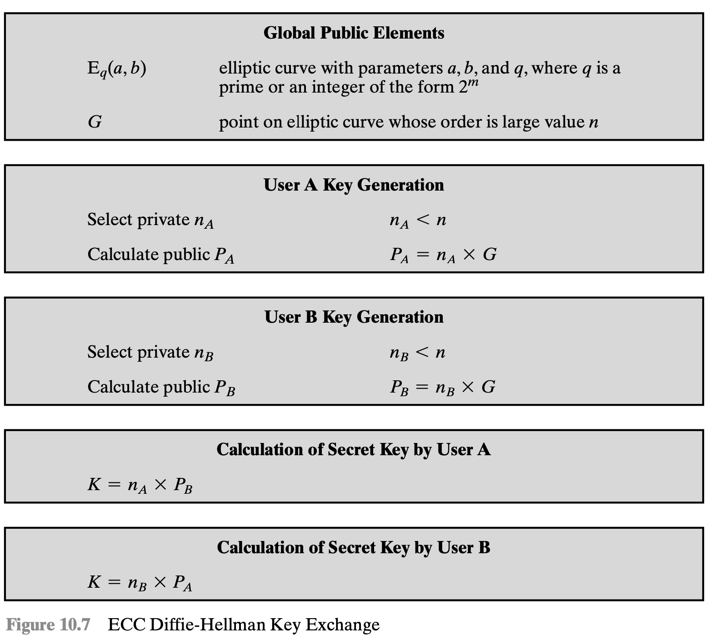
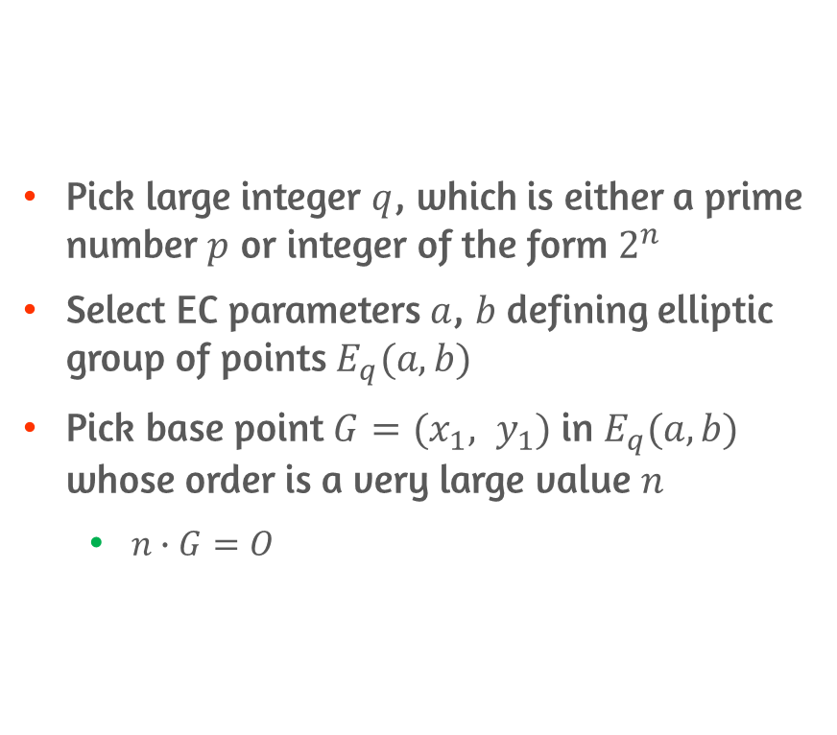
Setting Up Global Public Elements
Pick large integer $q$, which is either a prime number $p$ or integer of the form $2^{n}$
Select EC parameters $a$, $b$ defining elliptic group of points $E_{q}(a,b)$
Pick base point $G=(x_{1}, y_{1})$ in $E_{q}(a,b)$ whose order is a very large value $n$
$n∙G=O$

Slide 32
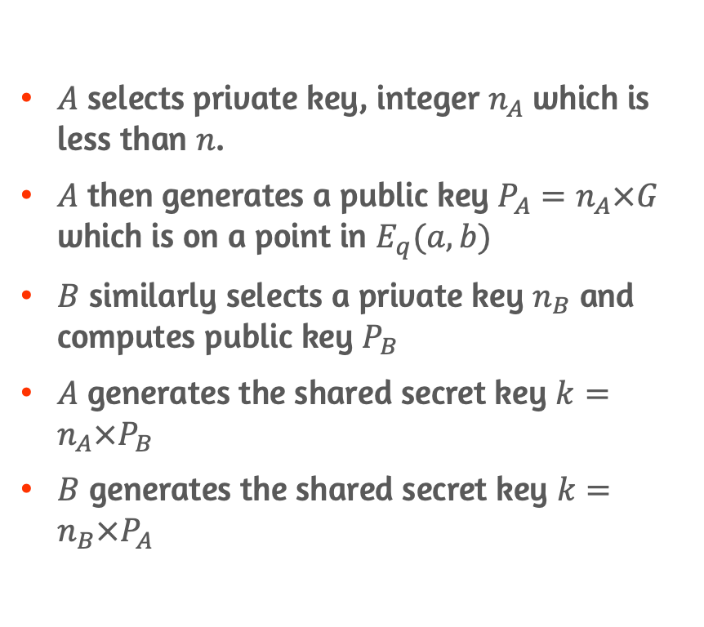

Key Exchange Between User $A$ and $B$
$A$ selects private key, integer $n_{A}$ which is less than $n$.
$A$ then generates a public key $P_{A}=n_{A}×G$ which is on a point in $E_{q}(a,b)$
$B$ similarly selects a private key $n_{B}$ and computes public key $P_{B}$
$A$ generates the shared secret key $k=n_{A}×P_{B}$
$B$ generates the shared secret key $k=n_{B}×P_{A}$

Slide 33
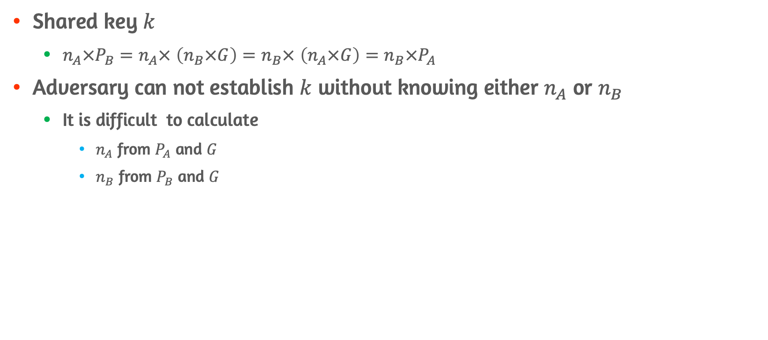

Shared Key $k$ and Security
Shared key $k$
$n_{A}×P_{B}=n_{A}×$ $\left(n_{B}×G\right)=n_{B}× \left(n_{A}×G\right)=n_{B}×P_{A}$
Adversary can not establish $k$ without knowing either $n_{A}$ or $n_{B}$
It is difficult to calculate
$n_{A}$ from $P_{A}$ and $G$
$n_{B}$ from $P_{B}$ and $G$

Slide 34
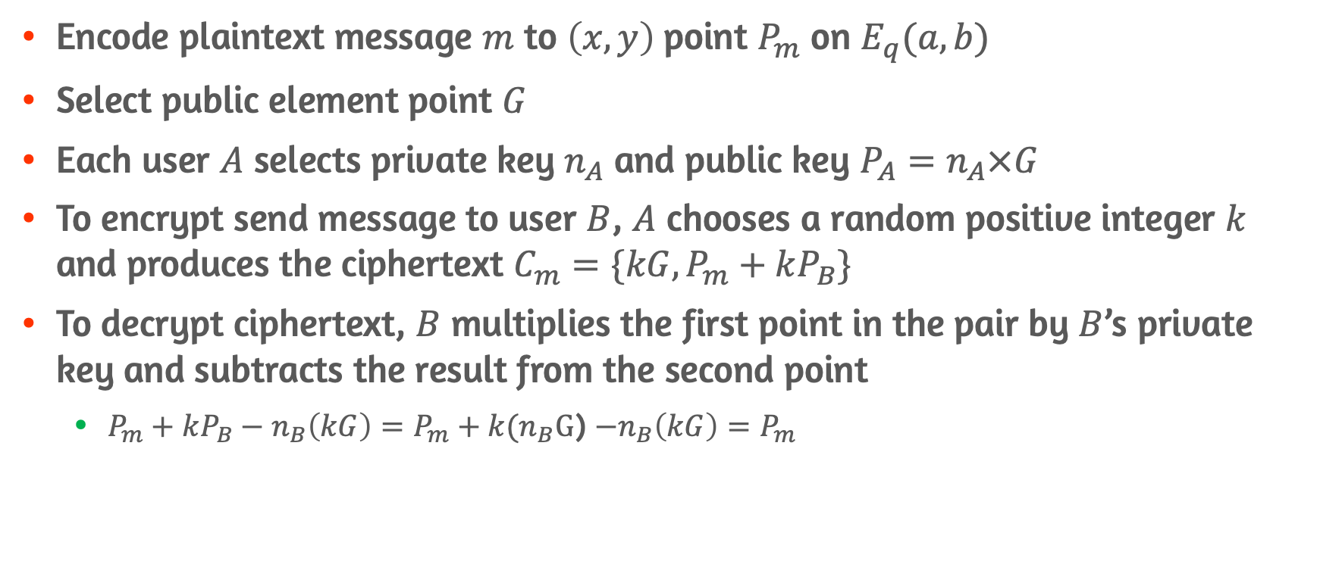
Elliptic Curve Encryption/Decryption
Encode plaintext message $m$ to $\left(x,y\right)$point $P_{m}$ on $E_{q}(a,b)$
Select public element point $G$
Each user $A$ selects private key $n_{A}$ and public key $P_{A}=n_{A}×G$
To encrypt send message to user $B$, $A$ chooses a random positive integer $k$ and produces the ciphertext $C_{m}=\{kG, P_{m}+kP_{B}\}$
To decrypt ciphertext, $B$ multiplies the first point in the pair by $B$’s private key and subtracts the result from the second point
$P_{m}+kP_{B}−n_{B}\left(kG\right)=P_{m}+k(n_{B}G$) $−n_{B}\left(kG\right)=P_{m}$

Slide 35
Conclusion
Define Diffie-Hellman key exchange
MITM attack on Diffie-Hellman key exchange
Overview of Elgamal cryptographic system
Elliptic curve arithmetic
Overview of elliptic curve cryptography

